Slide 1
Software Re-Engineering
Instructor: Muhammad Usman Shahid

Slide 2
Books
Text & Reference Books

Slide 3
Lecture 1: Content
Software Re-Engineering
Why Software Re-Engineering?
Real World Application of Software Re-Engineering

Slide 4
Software Re-Engineering
Software Re-engineering is a process of software development which is done to improve the maintainability of a software system. Re-engineering is the examination and alteration of a system to reconstitute it in a new form

Slide 5
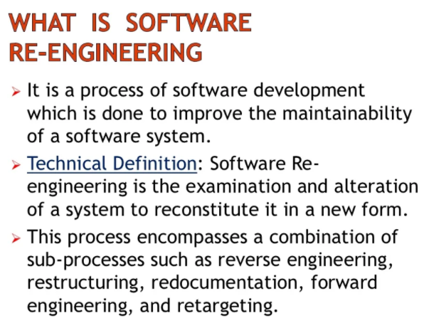
Software Re-Engineering

Slide 6
Re-Engineering Process
It is the combination of:
Source Code Translation
Reverse Engineering
Re-documentation
Re-Structuring
Translation
Forward Engineering

